Slide 1


Computational vision: EDGES
Class 3: Computational Vision
2021-2022

Slide 2
Recall: image filtering
Compute a function of the local neighborhood at each pixel in the image
Function specified by a “filter” or mask saying how to combine values from neighbors.
Uses of filtering:
Enhance an image (denoise, etc)
Extract information (edges, etc) – to see later
Detect patterns (template matching) – to see later
Adapted from Derek Hoiem

Slide 3
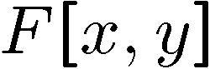
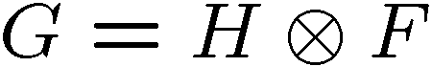
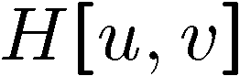
Linear filter
0 | 0 | 0 | 0 | 0 | 0 | 0 | 0 | 0 | 0
0 | 0 | 0 | 0 | 0 | 0 | 0 | 0 | 0 | 0
0 | 0 | 0 | 90 | 90 | 90 | 90 | 90 | 0 | 0
0 | 0 | 0 | 90 | 90 | 90 | 90 | 90 | 0 | 0
0 | 0 | 0 | 90 | 90 | 90 | 90 | 90 | 0 | 0
0 | 0 | 0 | 90 | 0 | 90 | 90 | 90 | 0 | 0
0 | 0 | 0 | 90 | 90 | 90 | 90 | 90 | 0 | 0
0 | 0 | 0 | 0 | 0 | 0 | 0 | 0 | 0 | 0
0 | 0 | 90 | 0 | 0 | 0 | 0 | 0 | 0 | 0
0 | 0 | 0 | 0 | 0 | 0 | 0 | 0 | 0 | 0
a | b | c
d | e | f
g | h | i
“box filter”

Slide 4
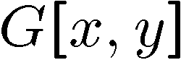
Linear filter
Normalization: divide the mask by (a+b+c+d+e+f+g+h+i)
0 | 0 | 0 | 0 | 0 | 0 | 0 | 0 | 0 | 0
0 | 0 | 0 | 0 | 0 | 0 | 0 | 0 | 0 | 0
0 | 0 | 0 | 90 | 90 | 90 | 90 | 90 | 0 | 0
0 | 0 | 0 | 90 | 90 | 90 | 90 | 90 | 0 | 0
0 | 0 | 0 | 90 | 90 | 90 | 90 | 90 | 0 | 0
0 | 0 | 0 | 90 | 0 | 90 | 90 | 90 | 0 | 0
0 | 0 | 0 | 90 | 90 | 90 | 90 | 90 | 0 | 0
0 | 0 | 0 | 0 | 0 | 0 | 0 | 0 | 0 | 0
0 | 0 | 90 | 0 | 0 | 0 | 0 | 0 | 0 | 0
0 | 0 | 0 | 0 | 0 | 0 | 0 | 0 | 0 | 0
 | 0 | 10 | 20 | 30 | 30
a | b | c
d | e | f
g | h | i
“box filter”
*1/(a+b+c+d+e+f+g+h+i)

Slide 5
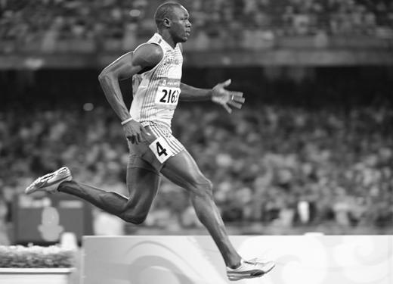

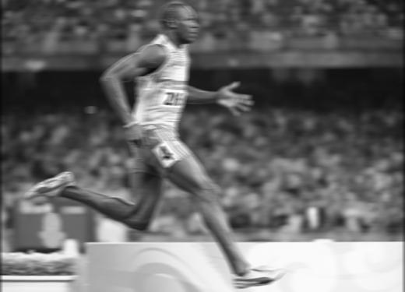
Review
f*g=?
original image
filtered
Filter f = 1/9 x [ 1 1 1 1 1 1 1 1 1]^{T}
o f = 1/9 x [ 1 1 1 1 1 1 1 1 1]?!
What happens if we have a smoothing filter that is unnormalized (does not sum to one)?

Slide 6
Today
What is an image derivative and its relation to the edges
How to implement different edge detectors and what is their difference?
First and second derivatives, image gradient and Laplacian
How to get image derivatives with a Gaussian function
Canny edge detector
Application: hybrid images

Slide 7
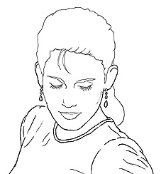
Edge detection
Goal: map image from 2d array of pixels to a set of curves or line segments or contours.
Why?
Main idea: look for strong gradients, post-process
Figure from J. Shotton et al., PAMI 2007
Notes:
https://jmperezperez.com/drawing-edges-svg/
https://www.youtube.com/watch?v=Ox4F8hjl4OM
https://www.youtube.com/watch?v=ZPxK3v7grQA

Slide 8
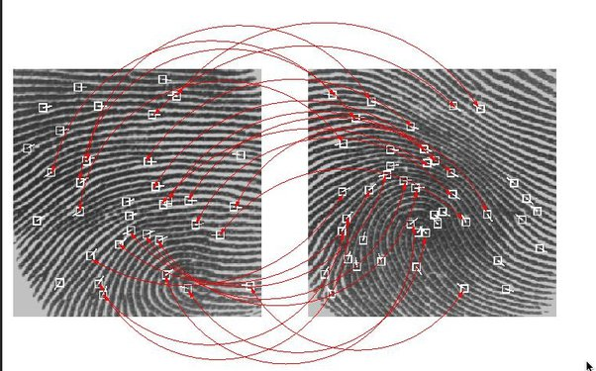
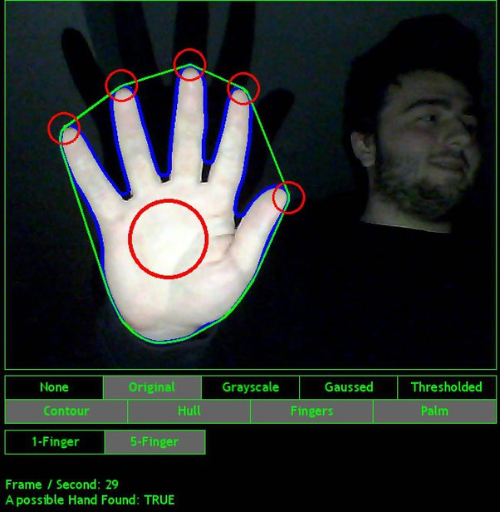
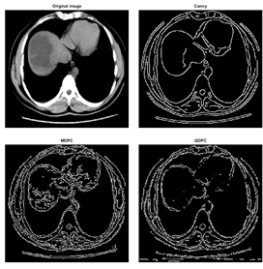
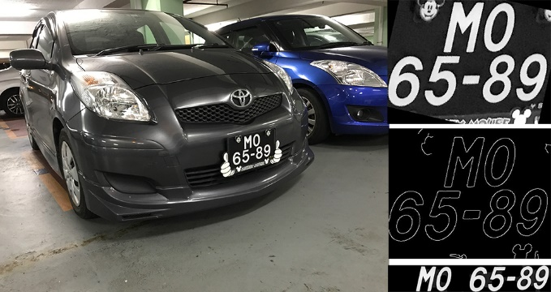
Why Edge detection?

Slide 9
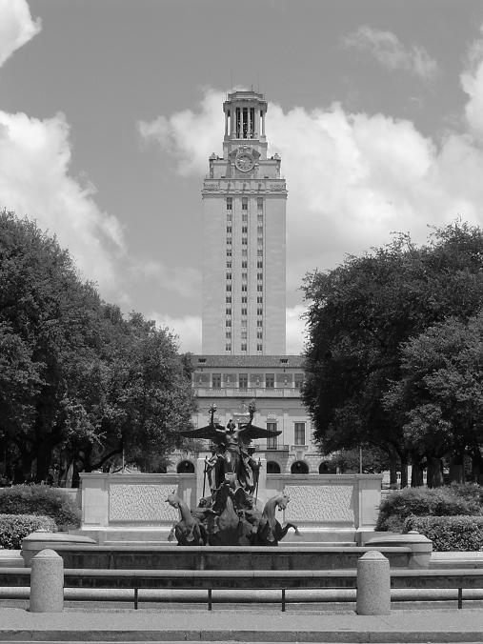
What does cause an edge?
Depth discontinuity: object boundary
Reflectance change: appearance information, texture
Cast shadows
Change in surface orientation: shape

Slide 10
Edges/gradients and invariance

Slide 11

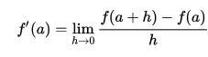
Derivatives and edges
An edge is a place of rapid change in the image intensity function.
intensity function (along horizontal scanline)
image
How to detect the points (pixels) of maximal change?
Source: L. Lazebnik

Slide 12
Derivatives and edges
An edge is a place of rapid change in the image intensity function.
intensity function (along horizontal scanline)
image
first derivative
Edges correspond to extremes of derivative
(max by absolute value)
Source: L. Lazebnik

Slide 13
Derivatives with convolution
But… the image is 2D!
For 2D function, f(x,y), the partial derivative in x is:
Does it make sense to get the derivative wrt 3rd dimension / channel?

Slide 14
Derivatives with convolution
But… the image is a discrete matrix!
We can approximate it using finite differences:
How to compute it on the image?

Slide 15
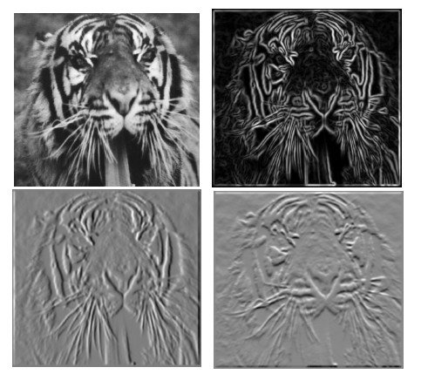
Partial derivatives of an image
What would be the associated convolution filter?
?
y
a | b | c
d | e | f
g | h | i
0 | b | 0
0 | -1 | 1
0 | 0 | 0
x
Recall:

Slide 16
Partial derivatives of an image
a | b | c
d | e | f
g | h | i
-1 1

Slide 17
Partial derivatives of an image
y
x
?
-1 1
1 -1
-1 1
or
Which derivative does show changes with respect to x?

Slide 18
First derivatives: discrete operators.
Given that the function f to derive our image I is:
1 -1
y
-1 1
Masks
x
Exercise: Which derivative will give maximal values on the image?
Petia Ivanova Radeva
18
Notes:
18

Slide 19
First derivatives: discrete operators.
Given that the function f to derive is our image I:
y
x
What happens when there is noise in the image?
Petia Ivanova Radeva
19
Notes:
19

Slide 20
First derivatives: discrete operators.
How to be less sensitive to noise?
y
x
Alternative: getting the average of the 3 derivatives in order to be less sensitive to noise:
Petia Ivanova Radeva
20
Notes:
20

Slide 21
First derivatives: discrete operators.
If we consider symetric finite differences:
y
x
What would be the conolution mask to compute the derivatives?
Mx=
My=
Prewitt masks
Petia Ivanova Radeva
21
Notes:
21

Slide 22
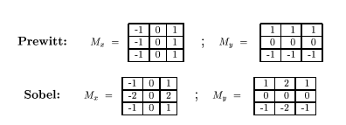
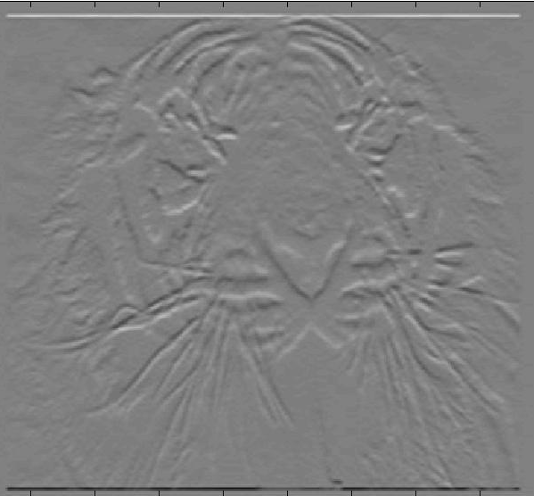
Assorted finite difference filters
What is the difference between the Prewitt and Sobel operators?
- Sobel, by using non-uniform weights, gives more importance to the closest neighbors.
Which do you expect to be better?

Slide 23
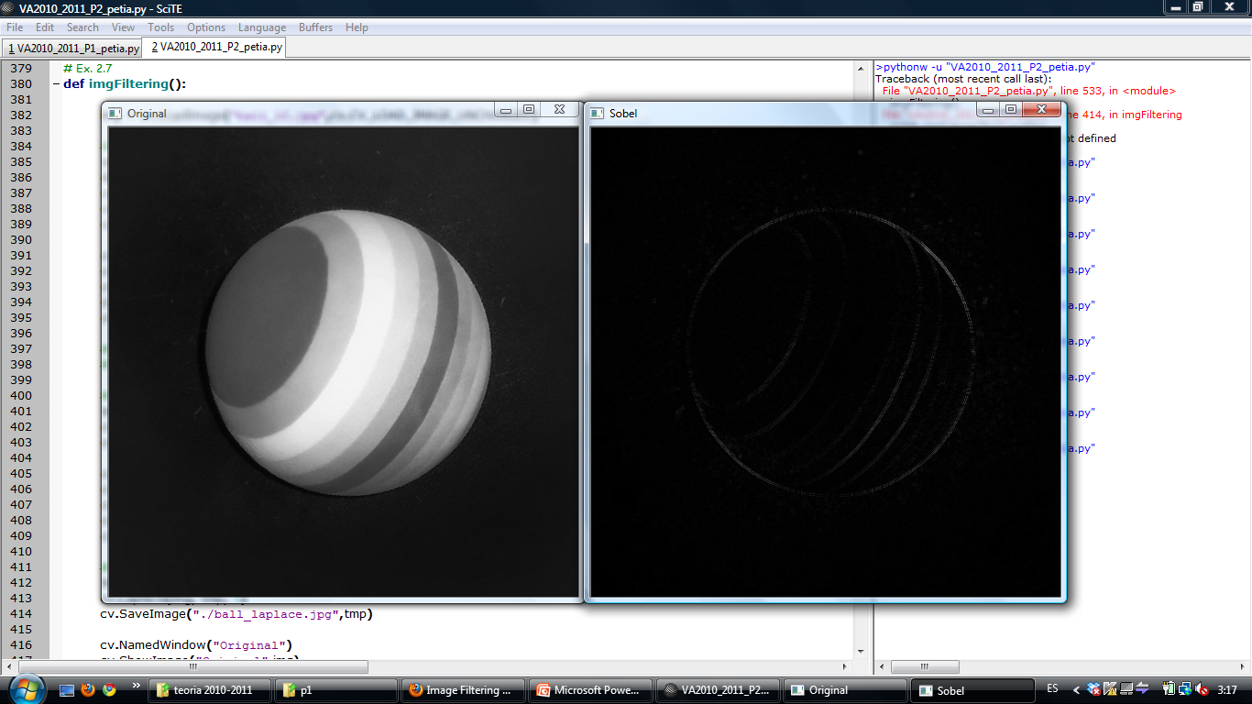
Assorted finite difference filters
Determine to which Sobel masks (wrt x and y) do these images correspond to?!
How to apply Sobel in skimage to detect the image edges?
Skimage:
>>from skimage import filters
>>im_vh=filters.sobel_v(im)
# Image should be float and gray value!
Petia Ivanova Radeva
23
Notes:
23

Slide 24
Assorted finite difference filters
Alternative:
>>from scipy.ndimage import >>convolveim_sv=convolve(im,mask)
How to combine both derivatives (in x and y)?
>>im_s=filters.sobel(im)
Petia Ivanova Radeva
24
Notes:
24

Slide 25

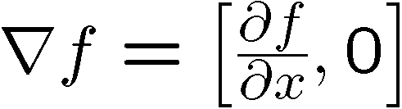
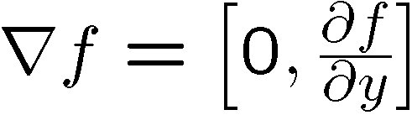
Image gradient
The gradient of an image:
The gradient points in the direction of most rapid change in intensity
Slide credit Steve Seitz
Notes:
25

Slide 26
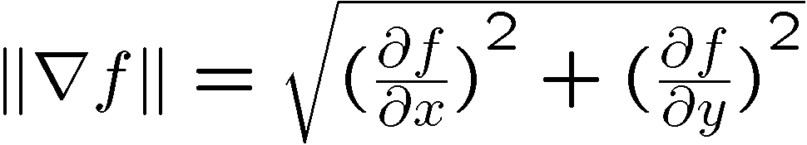
Image gradient
The edge strength is given by the gradient magnitude
Slide credit Steve Seitz
Notes:
26

Slide 27
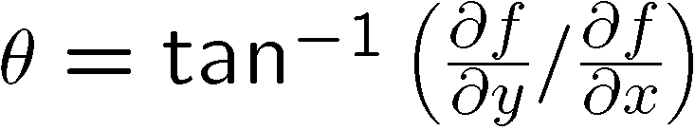
Image gradient
The gradient direction (orientation of edge normal) is given by:
Which aspect (magnitude or direction) is invariant to image contrast?
Slide credit Steve Seitz
Notes:
27

Slide 28
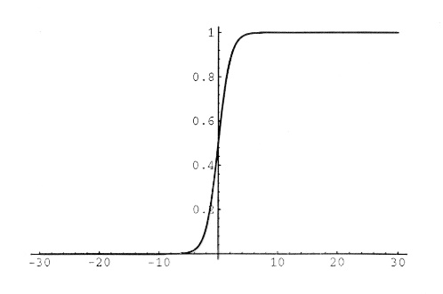
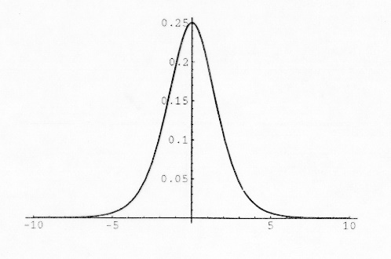
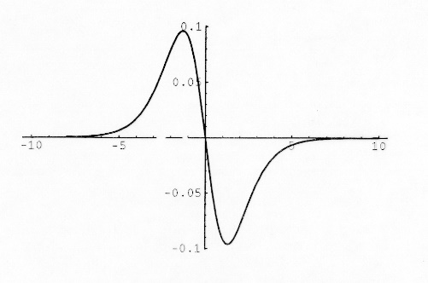
Discrete operators: second derivatives
What do you expect about the second derivatives?
Given an edge, the first derivative has an extreme, and the second one has a zero-crossing in the edge and extremes before and after the edge.
Petia Ivanova Radeva
28
Notes:
28

Slide 29
Discrete operators: second derivatives
What do you expect about the second derivatives?
Given an edge, the first derivative has an extreme, and the second one has a zero-crossing in the edge and extremes before and after the edge.
y
The second derivative is the derivative of the first derivative:
x
1 -2 1
Petia Ivanova Radeva
29
Notes:
29

Slide 30
Discrete operators: Laplacian
Let’s define:
Laplacian mask:
y
a | b | c
d | e | f
g | h | i
x
Petia Ivanova Radeva
30
Notes:
30

Slide 31
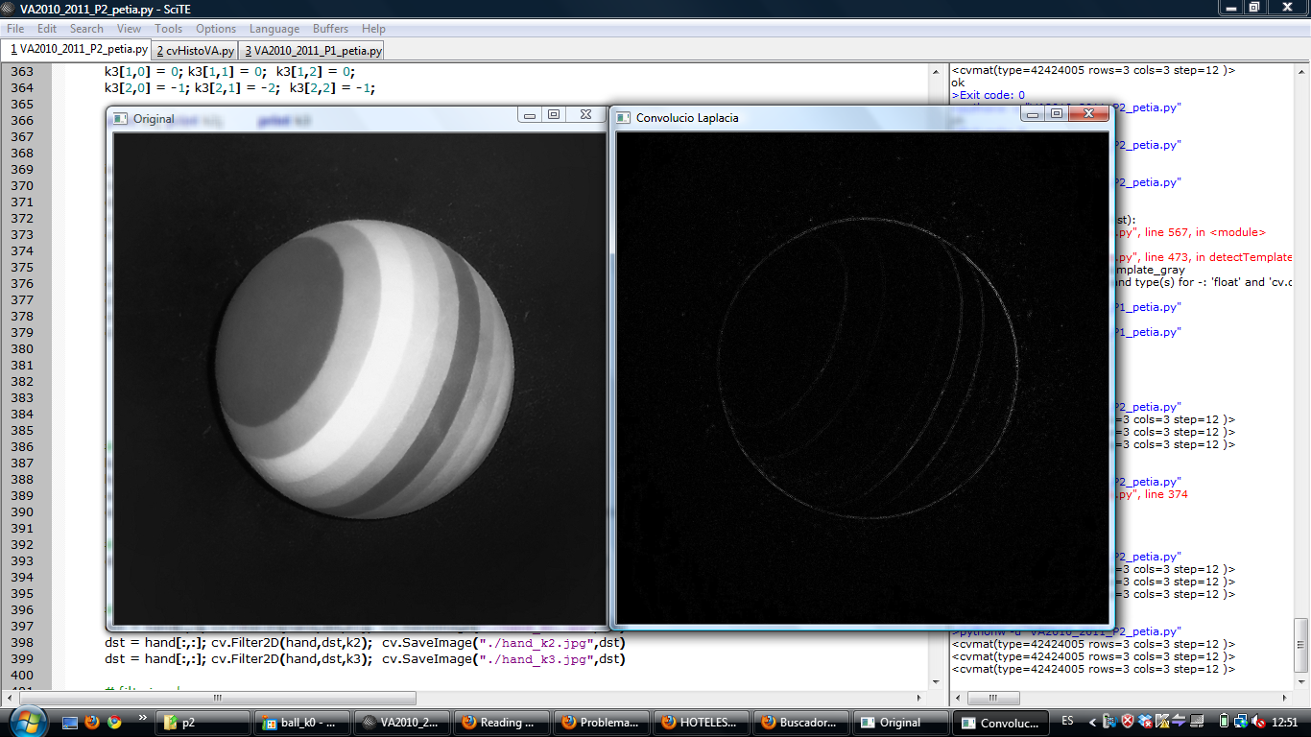
Discrete operators: Laplacian
Laplacian mask:
Skimage:
>> mask=numpy.array([[0,1,0],[1,-4,1],[0,1,0]], dtype='float')
>> im_l1= scipy.ndimage.convolve(skimage.img_as_float(im),mask)
Petia Ivanova Radeva
31
Notes:
31

Slide 32
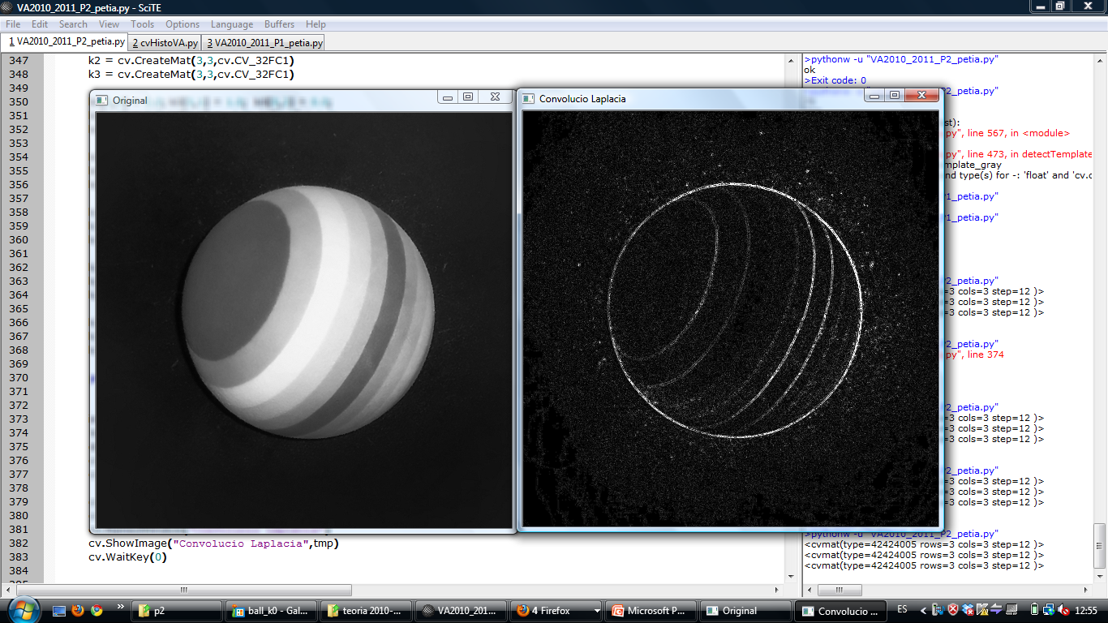
Discrete operators: Laplacian
Including the diagonal neighbours:
Laplacian:
Petia Ivanova Radeva
32
Notes:
32

Slide 33
Mask properties
Test on smoothing
Values should be _________
Sum to ___→ constant regions same as input
Amount of smoothing _____________ to mask size
Remove “______-frequency” components; “______-pass” filter
Test on derivatives
___________ signs used to get high response in regions of high contrast
Sum to ___ → no response in constant regions
_______________ value at points of high contrast

Slide 34
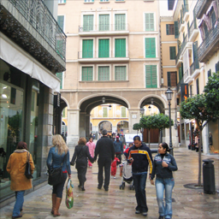
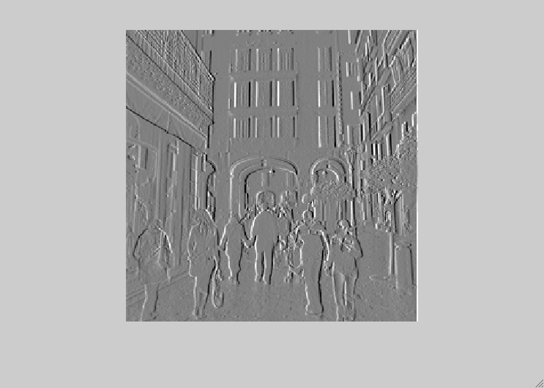
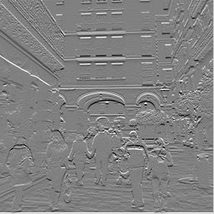
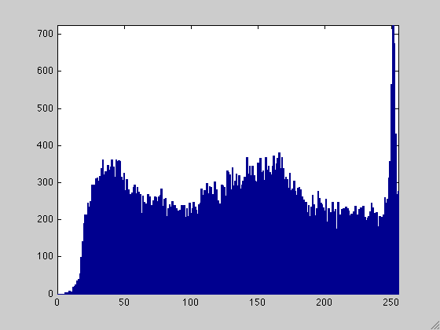
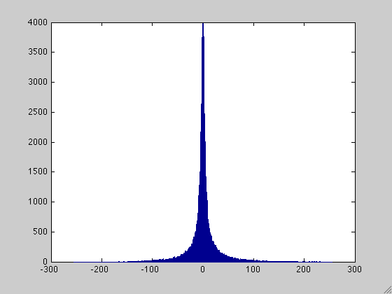
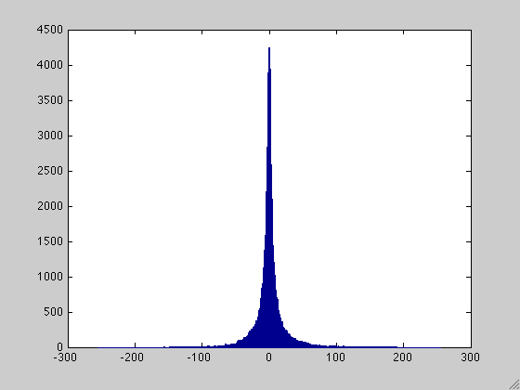
Explain the histogram of x and y edge maps
Horitzontal and vertical derivatives distribution: why are they positive and negative?
Why the maxima is in 0? Can I store them in a uint8 type image?.
Notes:
34

Slide 35
Today
What is an image derivative and its relation to the edges
How to implement different edge detectors and what is their difference?
First and second derivatives, image gradient and Laplacian
How to get image derivatives with a Gaussian
Canny edge detector
Application: hybrid images

Slide 36
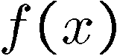
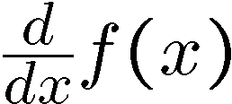
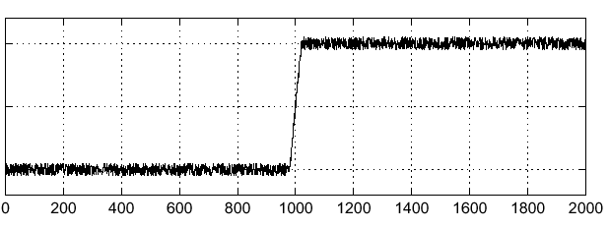
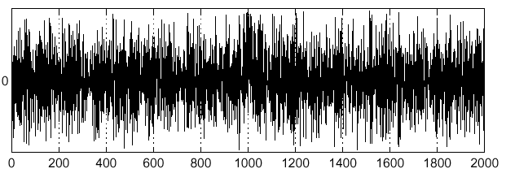
Effects of noise
Consider a single row or column of the image
Plotting intensity as a function of position gives a signal
Where is the edge?
Slide credit Steve Seitz

Slide 37
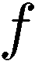
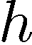
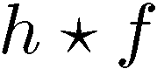
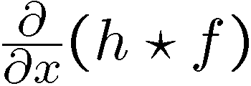
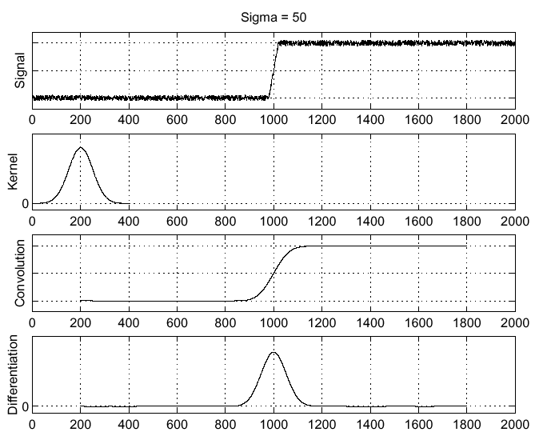
Solution: smooth first
Where is the edge?
Look for peaks in

Slide 38
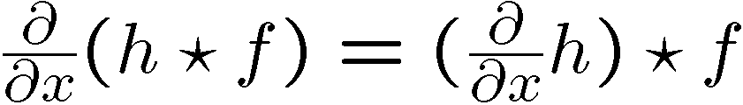
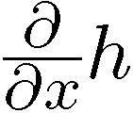
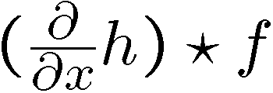
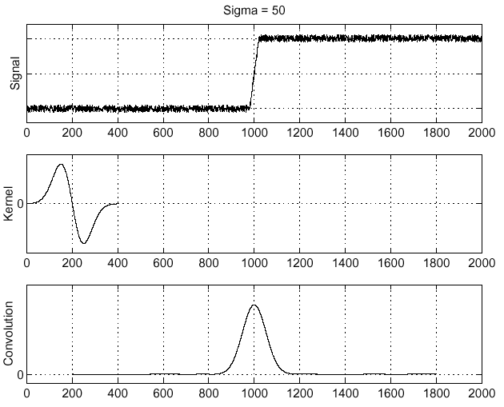
Derivative theorem of convolution
Differentiation property of convolution.
Slide credit Steve Seitz

Slide 39
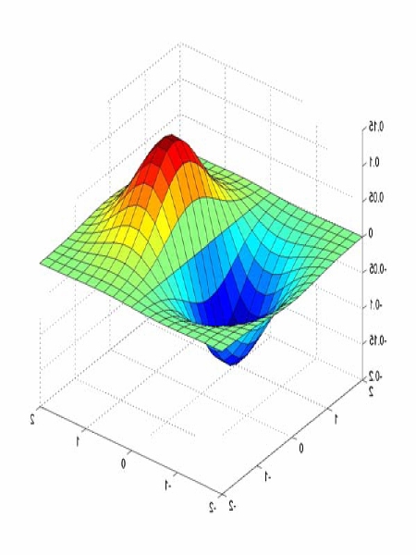
Derivative of Gaussian filters
0.0030 0.0133 0.0219 0.0133 0.0030
0.0133 0.0596 0.0983 0.0596 0.0133
0.0219 0.0983 0.1621 0.0983 0.0219
0.0133 0.0596 0.0983 0.0596 0.0133
0.0030 0.0133 0.0219 0.0133 0.0030

Slide 40
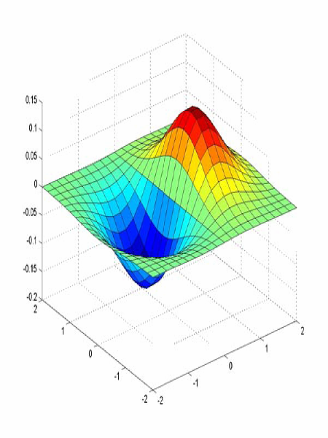
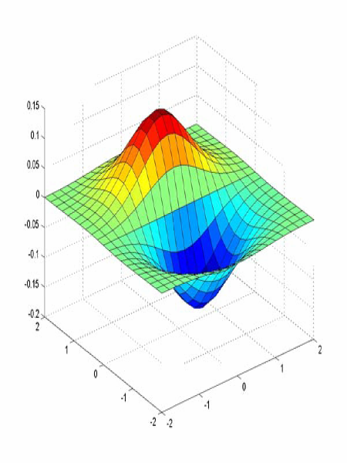
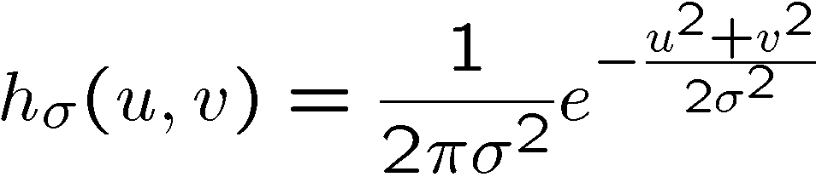
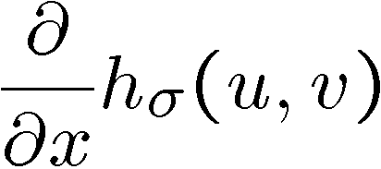
Derivative of Gaussian filters
x-direction
y-direction
Gaussian
Derivative of Gaussian
Source: L. Lazebnik

Slide 41
Implementation in Skimage
Gaussian
Derivative of Gaussian
In skimage:
>>im_gaus_der11=scipy.ndimage.filters.gaussian_filter(im, 1, order=[1,1])
>>im_gaus_der10=scipy.ndimage.filters.gaussian_filter(im, 1, order=[1,0])
>>im_gaus_der01=scipy.ndimage.filters.gaussian_filter(im, 1, order=[0,1])
It can be shown that convolving with a 2D Gaussian is the same that convolving with a 1D Gaussian in x direction followed by convolving in y direction!

Slide 42




Laplacian of Gaussian
Consider
Laplacian of Gaussian
operator
Where is the edge?
Zero-crossings of bottom graph
Slide credit: Steve Seitz

Slide 43






2D edge detection filters
Laplacian of Gaussian
Gaussian
Derivative of Gaussian
is the Laplacian operator:
Slide credit: Steve Seitz
Notes:
43

Slide 44






Smoothing with a Gaussian
Recall: parameter σ is the “scale” / “width” / “spread” of the Gaussian kernel, and controls the amount of smoothing.
…

Slide 45


Effect of σ on derivatives
σ = 1 pixel
σ = 3 pixels
The apparent structures differ depending on Gaussian’s scale parameter.
Larger values: ……… scale edges detected.
Smaller values: ………features detected.

Slide 46
Laplacian
Skimage:
im_l=filters.laplace(im)

Slide 47





Laplacian and zero-crossings
Using different sigma values.
Why edges obtained by the zero-crossing of the Laplacian map assure to be continuous?
Although the Laplacian operator convolved with the image leads to contours, they can be too much (depends on sigma).

Slide 48
Today
What is an image derivative and its relation to the edges
How to implement different edge detectors and what is their difference?
First and second derivatives, image gradient and Laplacian
How to get image derivatives with a Gaussian
Canny edge detector
Application: hybrid images

Slide 49







So, what scale to choose?
It depends what we’re looking for.
We need previous knowledge about the right scale.
Or manage different scales. How?

Slide 50

Original image

Slide 51

Gradient magnitude image

Slide 52

Thresholding gradient with a lower threshold

Slide 53

Thresholding gradient with a higher threshold

Slide 54
Canny edge detector
Filter image with derivative of Gaussian
Find magnitude and orientation of gradient
Non-maximum suppression:
Thin wide “ridges” down to single pixel width
Linking and thresholding (hysteresis):
Define two thresholds: low and high
Use the high threshold to start edge curves and the low threshold to continue them
Skimage:
>>im_canny=skimage.feature.canny(im, sigma=5)
Source: D. Lowe, L. Fei-Fei

Slide 55

The Canny edge detector
original image (Lena)
Slide credit: Steve Seitz

Slide 56

The Canny edge detector
norm of the gradient

Slide 57

The Canny edge detector
thresholding

Slide 58


The Canny edge detector
How to turn these thick regions of the gradient into curves?
thresholding

Slide 59

Non-maximum suppression
Check if pixel is local maximum along gradient direction, select single max across width of the edge

Slide 60

The Canny edge detector
Problem: pixels along this edge didn’t survive the thresholding
thinning
(non-maximum suppression)

Slide 61
Hysteresis thresholding
Use a high threshold to start edge curves, and a low threshold to continue them.
Source: Steve Seitz

Slide 62
Hysteresis thresholding
original image
high threshold
(strong edges)
low threshold
(weak edges)
hysteresis threshold
Source: L. Fei-Fei

Slide 63
Hysteresis thresholding
original image
high threshold
(strong edges)
low threshold
(weak edges)
hysteresis threshold
Source: L. Fei-Fei

Slide 64
Recap: Canny edge detector
Filter image with derivative of Gaussian
Find magnitude and orientation of gradient
Non-maximum suppression:
Thin wide “ridges” down to single pixel width
Linking and thresholding (hysteresis):
Define two thresholds: low and high
Use the high threshold to start edge curves and the low threshold to continue them
In skimage:
>>im_canny=skimage.feature.canny(im, sigma=5)
Source: D. Lowe, L. Fei-Fei

Slide 65
Canny edge detector

Slide 66

Exercices (comparison)
Determine the operator applied:
Original image
Sobel with a mask
mask=np.array([[-1,0,1],[-2,0,2],[-1,0,1]], dtype='float')
im_sobel=convolve(im,mask)
Prewitt with a mask
mask=np.array([[-1,0,1],[-1,0,1],[-1,0,1]], dtype='float')
im_prewitt=convolve(im,mask)
Laplacian with a mask
mask=np.array([[0,-1,0],[-1,4,-1],[0,-1,0]], dtype='float')
im2=convolve(im,mask)
fig=plt.imshow(im2<7.5, cmap='gray')
Laplacian with a mask
mask=np.array([[1,4,1],[4,-20,4],[1,4,1]], dtype='float')
im_Lapl=convolve(im,mask)

Slide 67
Exercices (comparison)
Determine the operator applied:
Original image
Sobel
im2=filters.sobel(im)
fig=plt.imshow(abs(im2)>10.5)
Laplacian of a Gaussian
im2=filters.laplace(im)
Canny sigma=4
im2=feature.canny(im, sigma=4)
Canny sigma=6.5
im2=feature.canny(im, sigma=6.5)

Slide 68
Canny edge detector Limitations
Canny detector only focuses on local changes and it has no semantic understanding.
Canny Edge detector fails in this case as it has no understanding of the content of the image.
There are alternatives as the one in OpenCV: Holistically-Nested Edge Detection (HED), an end-to-end deep neural network. [Saining Xie, Zhuowen Tu “HED” 2015]

Slide 69






Low-level edges vs. perceived contours
Background
Texture
Shadows
Is Canny edge detector distinguishing these contours?

Slide 70






Low-level edges vs. perceived contours
image
human segmentation
gradient magnitude
Berkeley segmentation database: http://www.eecs.berkeley.edu/Research/Projects/CS/vision/grouping/segbench/
Source: L. Lazebnik

Slide 71

Learn from humans which combination of features is most indicative of a “good” contour?
[D. Martin et al. PAMI 2004]
Human-marked segment boundaries

Slide 72
Today
What is an image derivative and its relation to the edges
How to implement different edge detectors and what is their difference?
First and second derivatives, image gradient and Laplacian
How to get image derivatives with a Gaussian
Canny edge detector
Application: hybrid images

Slide 73

Application: Hybrid Images
Aude Oliva & Antonio Torralba & Philippe G Schyns, SIGGRAPH 2006
Notes:
\

Slide 74
Intuition about low and high image frequencies
Sum of 50 frequencies
Low frequencies -> pixel values that are changing slowly over space.
High frequency -> pixel values that are rapidly changing in space.

Slide 75


Application: Hybrid Images
Low image frequencies
How to extract them?
High image frequencies
A. Oliva, A. Torralba, P.G. Schyns, “Hybrid Images,” SIGGRAPH 2006

Slide 76
Application: Hybrid Images
Gaussian Filter
Low frequencies:
L(I1) -> Gaussian smoothing
High frequencies:
H(I2)=I2 - L(I2)
Laplacian Filter or the difference btw the image and its low frequencies
A. Oliva, A. Torralba, P.G. Schyns, “Hybrid Images,” SIGGRAPH 2006

Slide 77
Application: Hybrid Images
Low frequencies
High frequencies
Hybrid image:
Hybrid(I1,I2)=L(I1)+H(I2)
Note: In order to emphasize the effect, use different sigma parameters in the Gaussian
A. Oliva, A. Torralba, P.G. Schyns, “Hybrid Images,” SIGGRAPH 2006

Slide 78

Aude Oliva & Antonio Torralba & Philippe G Schyns, SIGGRAPH 2006

Slide 79

http://cvcl.mit.edu/hybrid_gallery/gallery.html

Slide 80

Aude Oliva & Antonio Torralba & Philippe G Schyns, SIGGRAPH 2006

Slide 81
Summary
Filters allow local image neighborhood to influence our description and features
Smoothing to reduce noise
Derivatives to locate contrast, high image gradient
Different edge detectors:
Sobel & Prewitt – fast but sensitive to noise
Convolution with the Gradient of a Gaussian –
Less fast but more robust
Using different sigma allows to smooth more or less
Zero-crossing with a Laplacian – assures closed contours
Canny edge detector – state of the art edge detector
Assures continuous and thin contours due to the hysteresis and the thinning steps but needs parameters
Edges used to contain good contours but also many other pixels with high intensity change
Still the question about the object contours is not solved!

Slide 82

Let’s do some test
Go to socrative.com
Room: ComputerVision2122

